Slide 1
INDUSTRIAL TRAINING
Simple N Layer Neural Network
Vardaan Pruthi
40913302717
CSE 7B

Slide 2
STEPS INVOLVED …
IMAGE PREPROCESSING
RANDOM INTIALIZATION
FORWARD PROPAGATION & COST COMPUTATION
BACKWARD PROPAGATION & PARAMETER UPDATE
PREDICTION

Slide 3
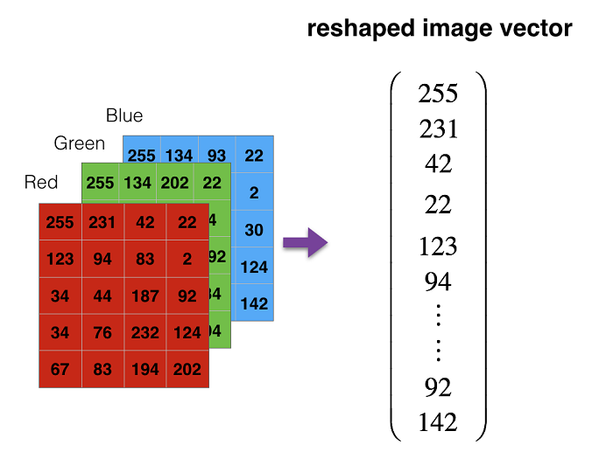
IMAGE PREPROCESSING

Slide 4
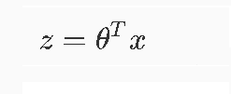


FORWARD PROPAGATION & COST COMPUTATION
Hypothesis function
Activation Function
Cost Computation

Slide 5
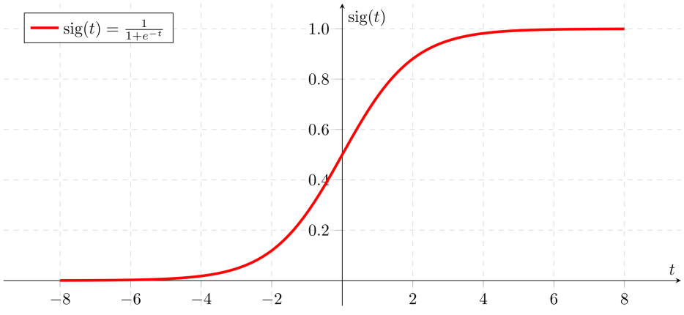
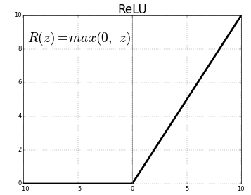
Activation Functions
Sigmoid
S(z)=1/(1+e^-z)
RELU
R(z)=max(0,z)

Slide 6
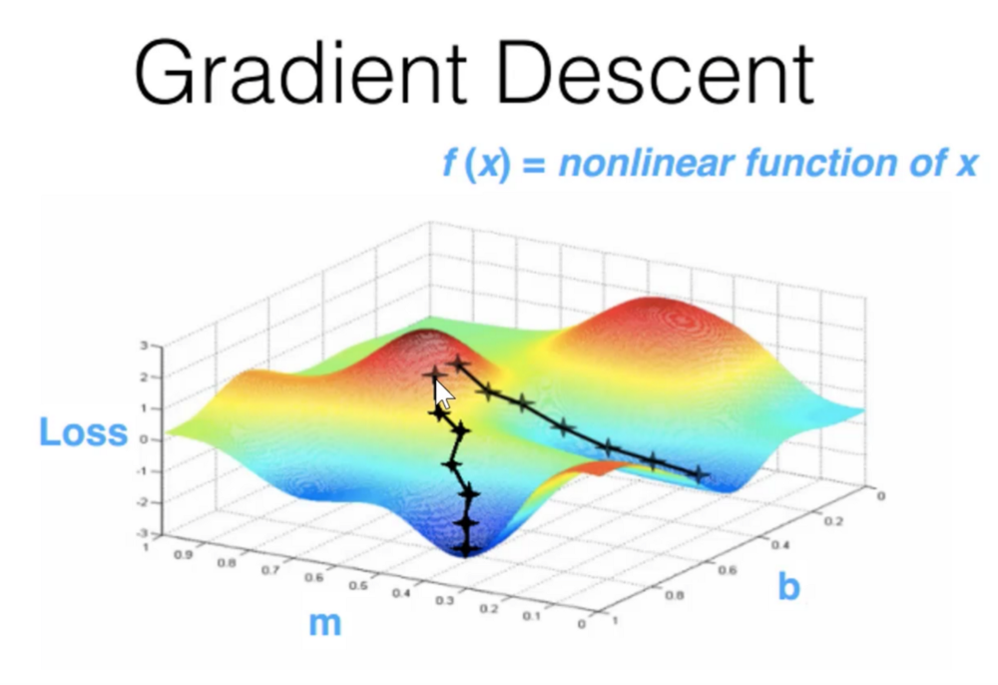
BACK PROPAGATION & PARAMETER UPDATE
Back Propagation
dw and db vectors are calculated for each layer
Parameter Update
W-Dw and B-Db for each layer
Algorithm used is

Slide 7
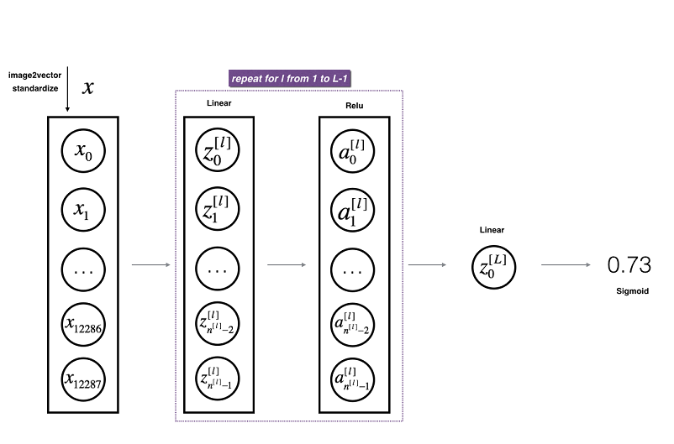
NEURAL NETWORK BASIC ARCHITECTURE
This means that there is a 73% chance that this is a cat image.

Slide 8
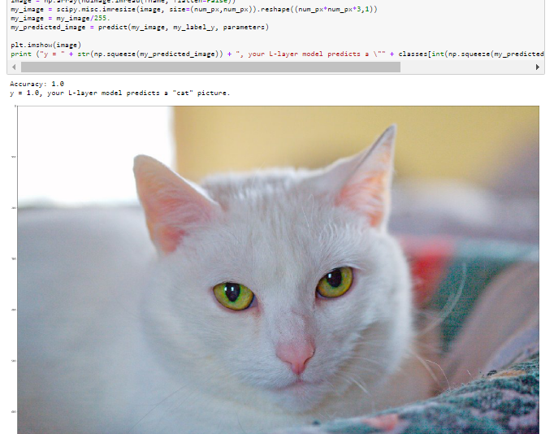
PREDICTION

Slide 9
THANK YOU

